Slide 1
SMART PUBLIC TRANSPORTATION presented by:- n.ganesh k.subhash m.sahith b.rambabu b.revanth

Slide 2
OBJECTIVES
PROVIDE BASIC INFRASTRUCTURE
QUALITY OF LIFE

Slide 3
INTRODUCTION
Main motto of the project is to make the public transport smarter.
City transportation is an important pillar for quality of life of citizens in a city.
Technology plays an important role by predicting demand and supply data.

Slide 4
DESCRIPTION
Lack of quality and safe transportation inadequate capacity of public transportation, road safety measures and overcrowded road network and poor traffic management etc.
By this project we will be able to provide the details of the bus like present location of the bus and the number of seats available and at what time the bus can be reached to their location.

Slide 5
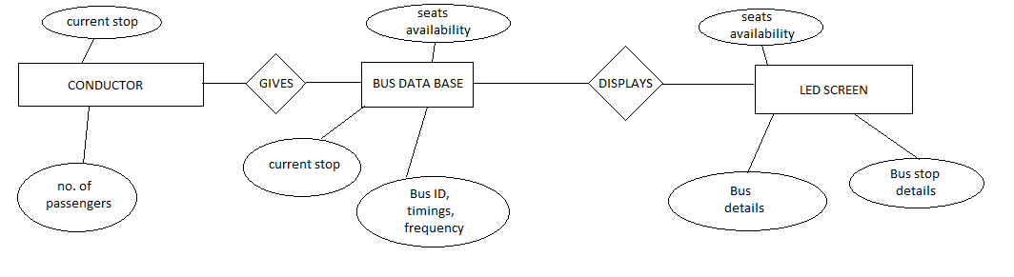
DATA FLOW

Slide 6
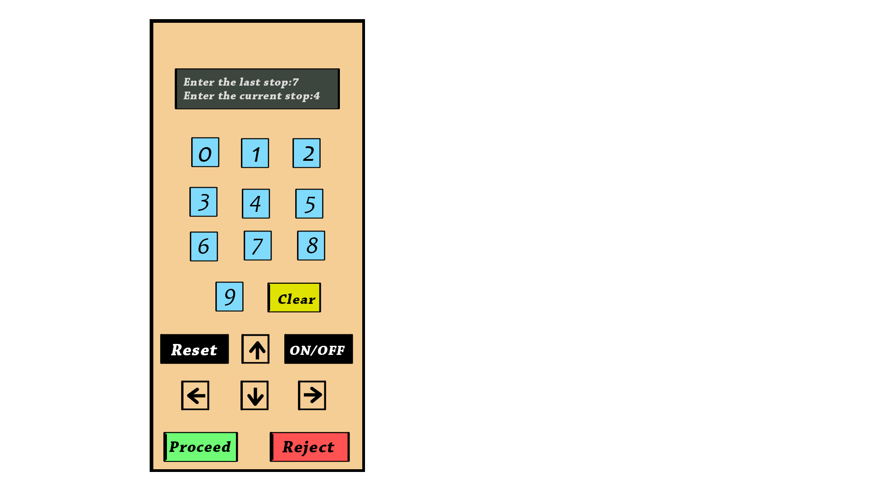
DEVICE OF CONDUCTOR

Slide 7
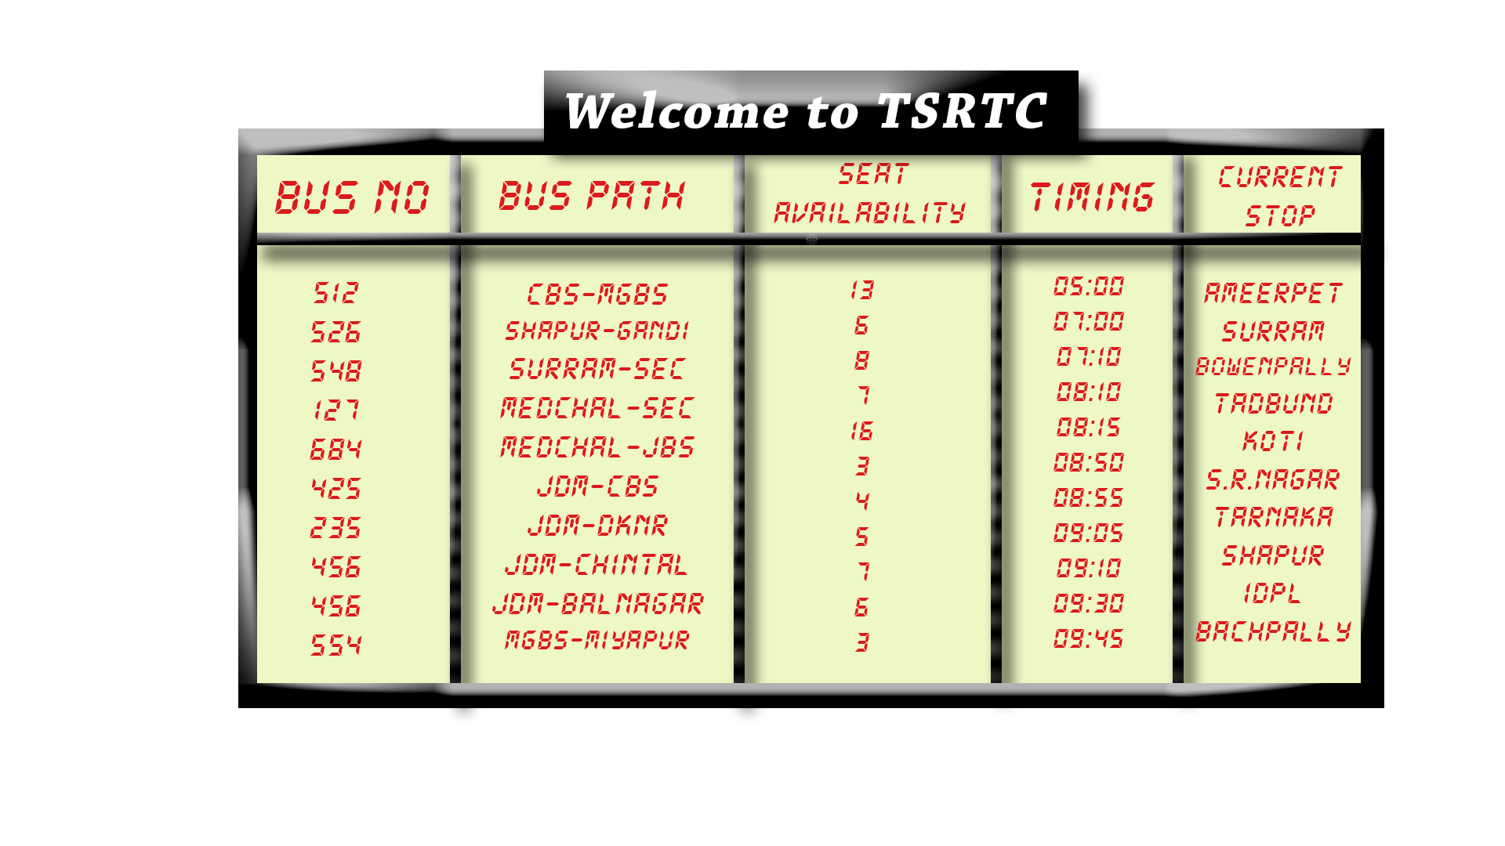
LED DISPLAY AT BUS STOP

Slide 8
ADVANTAGES
To provide safe transport.
To remove overcrowd in the bus.
Providing the details of the bus.
It shows the real time traffic.

Slide 9
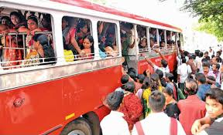
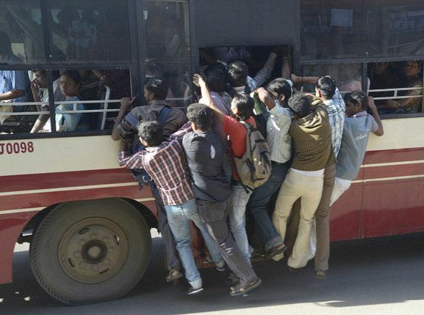
OVERCROWD OF BUSES.

Slide 10
CONCLUSION
By this project we can provide smart transportation for the public.
We can overcome accidents in day to day life.
To enhance safety and security to the public.

